Slide 1
Croquet...
Don’t be left out!

Slide 2
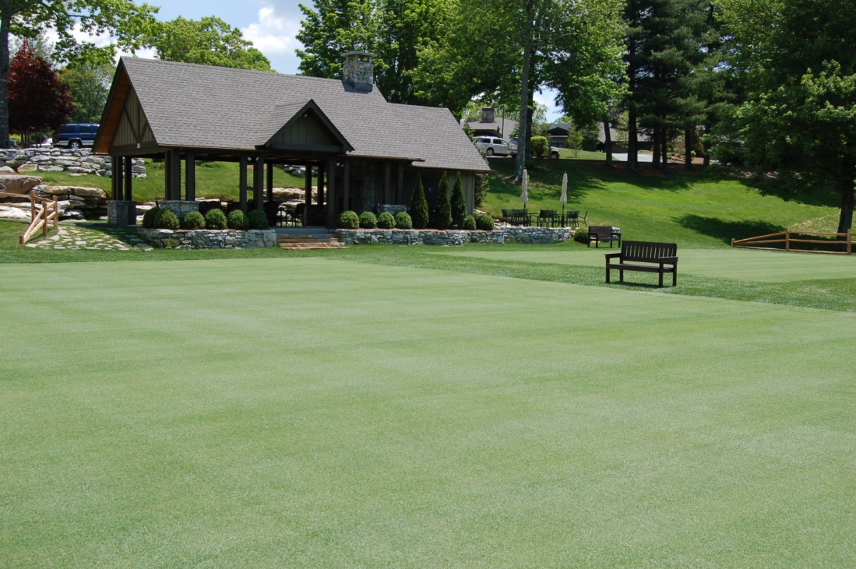
Why, You Ask?
As evidenced by the big surge of croquet in the mountains of North Carolina, many clubs are now building lawns to be competitive within the market place. You can’t afford not to have one!

Slide 3
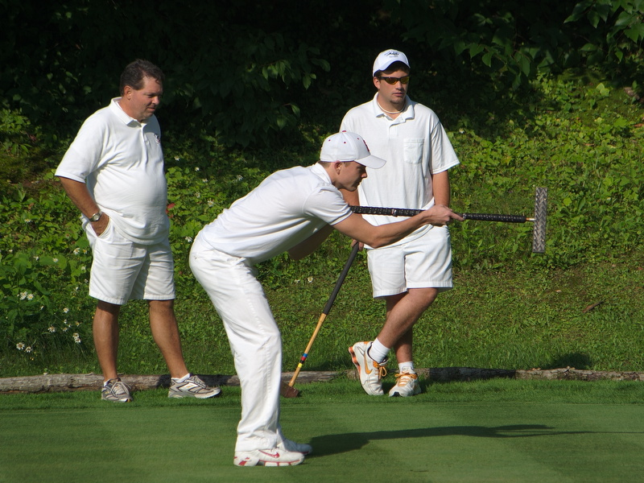
Growing in Popularity
Currently over 4.5 million people are playing croquet in the United States.

Slide 4
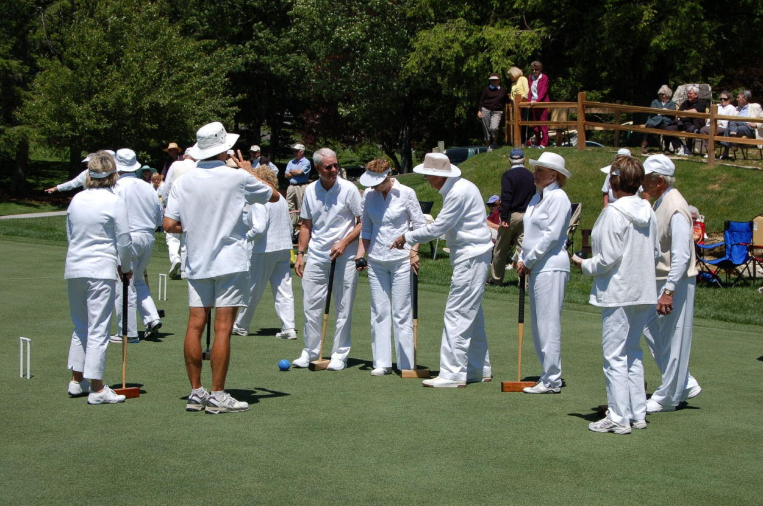
Members Love It!
It’s very social

Slide 5
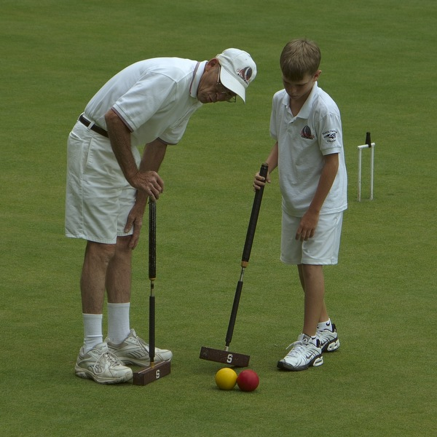
Who Can Play?
Everyone! It’s Age & gender neutral
Brings people of all interests together

Slide 6
Replacement Sport
It’s a GREAT replacement sport
Jim Estes, Member
Highlands Falls Country Club
“It happened to me – it has happened to so many. I was a typical amateur jock in multiple sports including tennis, racquetball, skiing and even single digit golf. Four back surgeries later, it all came to an end. But, then I found croquet! I now enjoy playing a sport competitively again. I find croquet to be demanding in skill and strategy, while being easy on the body.”

Slide 7
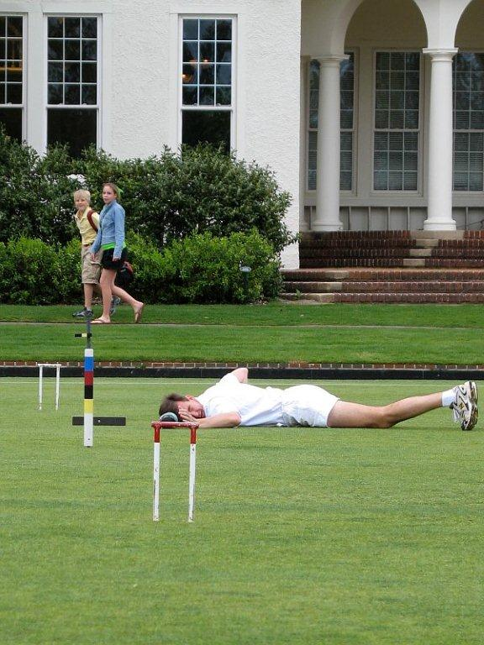
It’s Challenging...Or Not!
It’s as competitive as YOU want it to be!

Slide 8
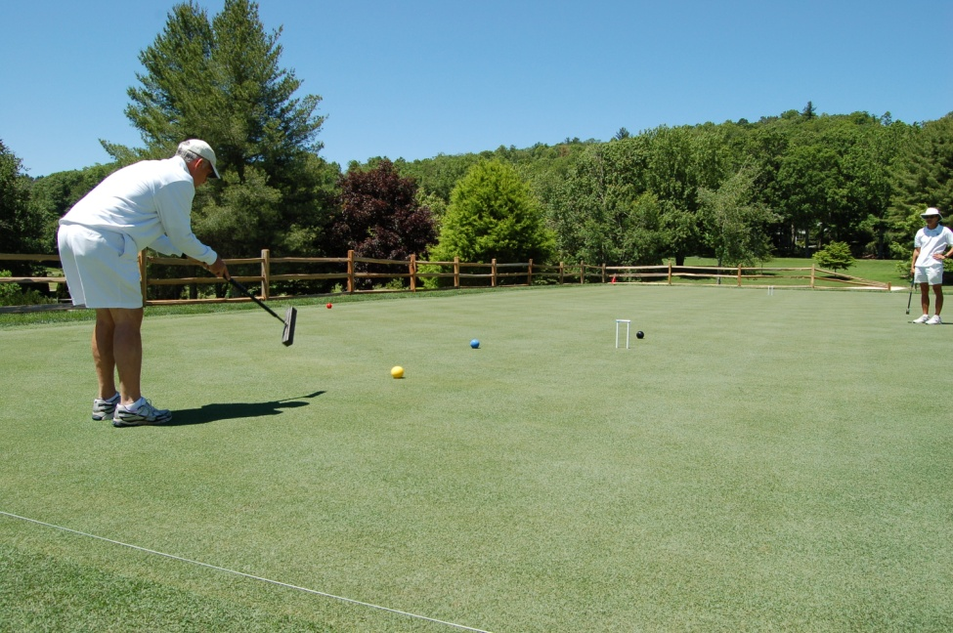
It’s Low Impact
Easy on the body
Easy on the Knees

Slide 9
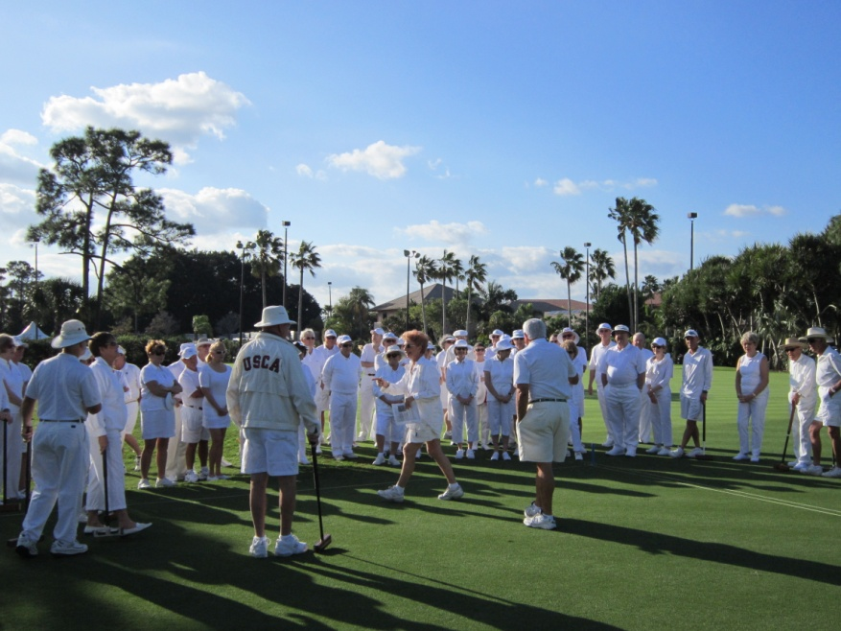
Clubs Need It!
Increases membership
Increases member retention
Improves camaraderie

Slide 10
Bottom Line Benefits
Attractive to Corporate Groups
Provides increased revenues:
Golf Shop Revenues: 20% Increase
Mallet Sales
Clothing Sales
Dining Revenues 3% - 5% increase

Slide 11
Testimonials
Jason Macaulay, GM
Highlands Falls Country Club
“Croquet has been an amazing addition to our Club. Added in June 2012, we never dreamed that it would be this popular. Just one year later, we have more croquet players than golfers. It’s the smartest thing we’ve ever done.”

Slide 12
Testimonials
David Dew, President
Lake Toxaway Country Club
“Croquet has become an increasingly popular activity, particularly in the mountains of western North Carolina.” We are proud to say that we were one of the first clubs in the area to offer this fun and competitive sport to our members.”

Slide 13
How To Get Started
Join the USCA as a member club for access to human and financial resources. http://www.croquetamerica.com/usca/about/

Slide 14
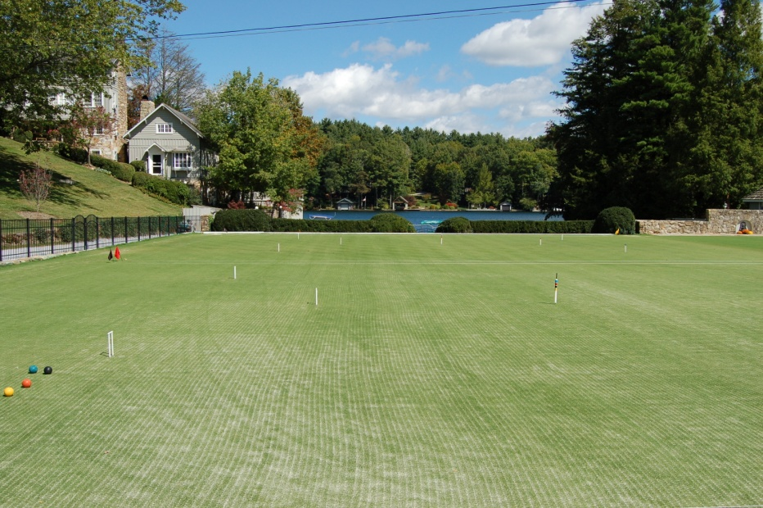
Start Up Costs
$50,000 - $75,000 for one standalone lawn
Dimensions:
30 yards x 40 yards
Consider building two lawns

Slide 15
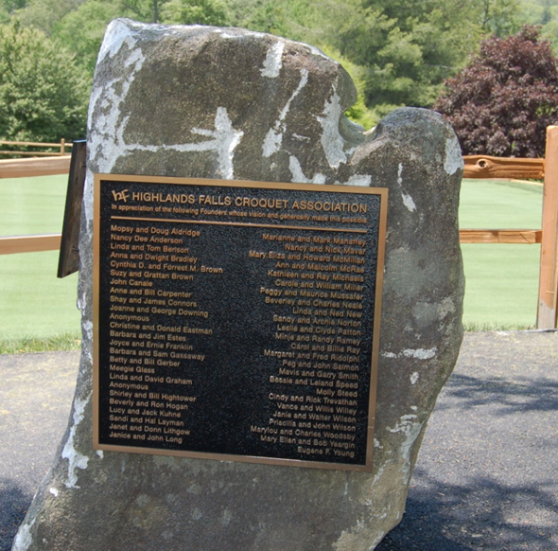
Private Financing
Raising Funds through Member Donations

Slide 16
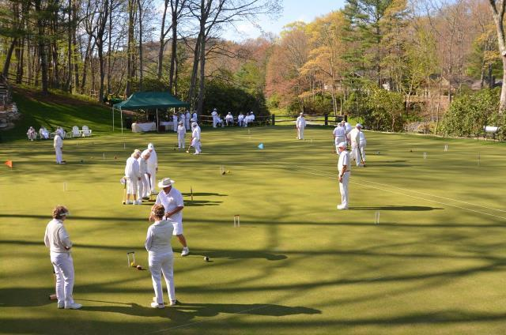
Club Financing
Add to the Club’s Annual Budget
Finance the project in full or in part

Slide 17
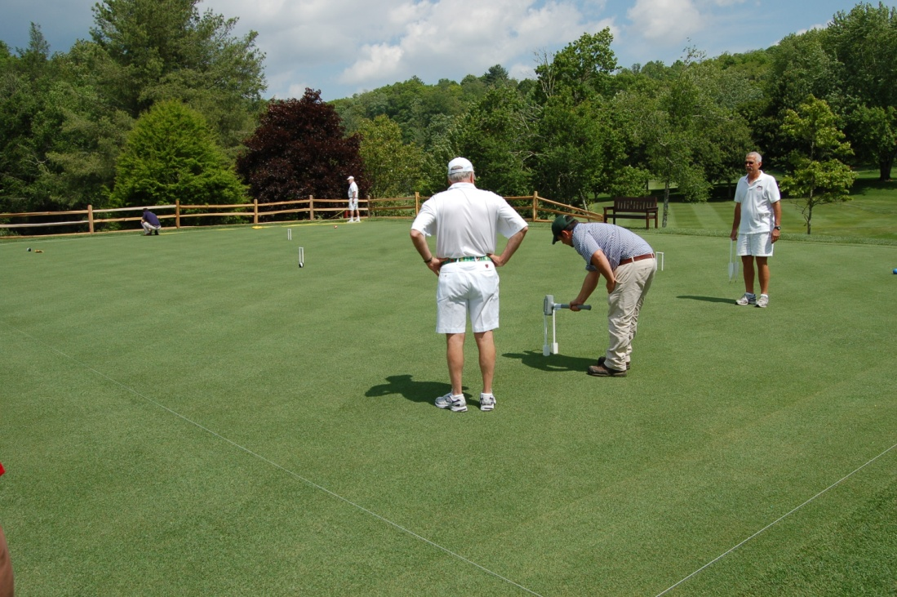
Other Costs
Regular maintenance by Greens and Grounds crew
ROI from increased revenue in food, beverage, clothing and equipment sales

Slide 18
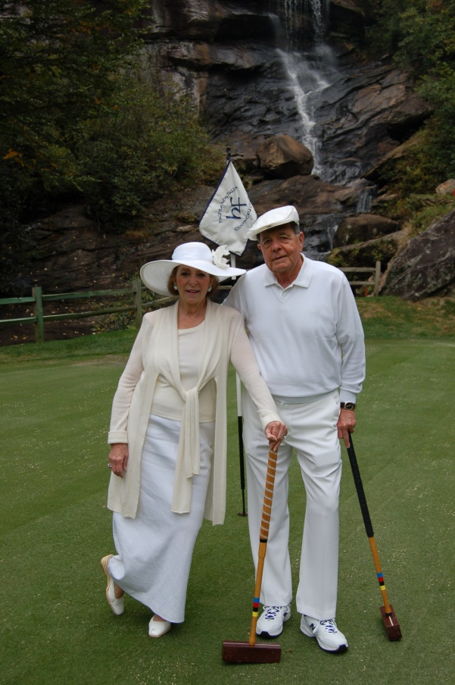
Games To Play
Golf Croquet
Easy to learn
Easy to teach

Slide 19
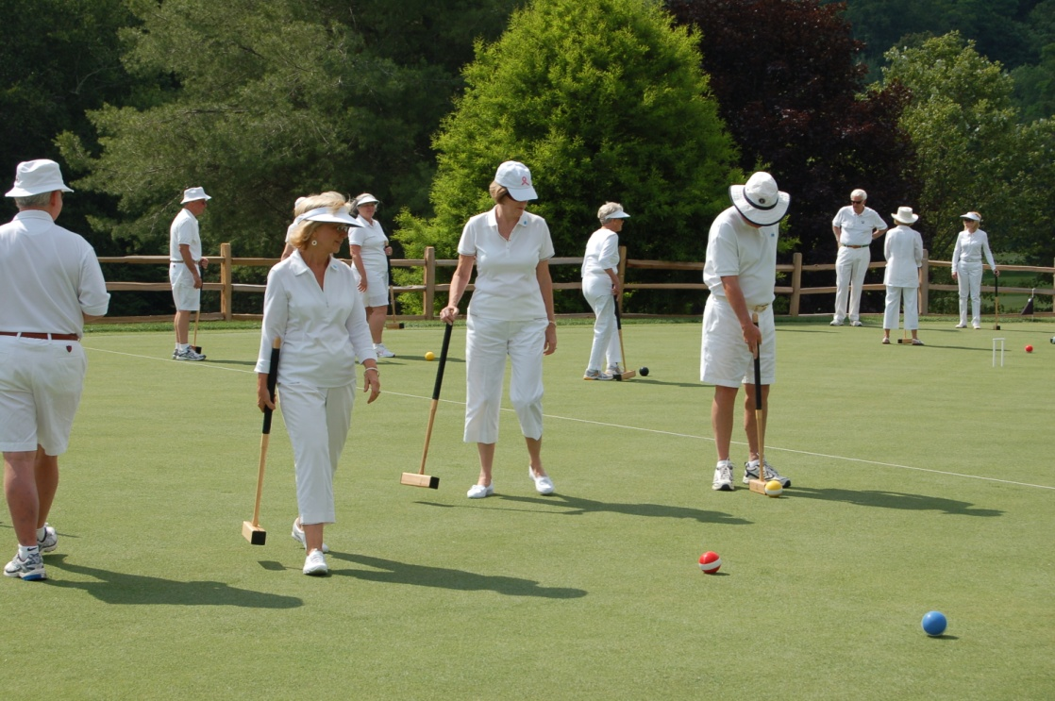
It’s Good for Membership
Be proactive:
Look for ways to keep your members longer
Attract new members

Slide 20
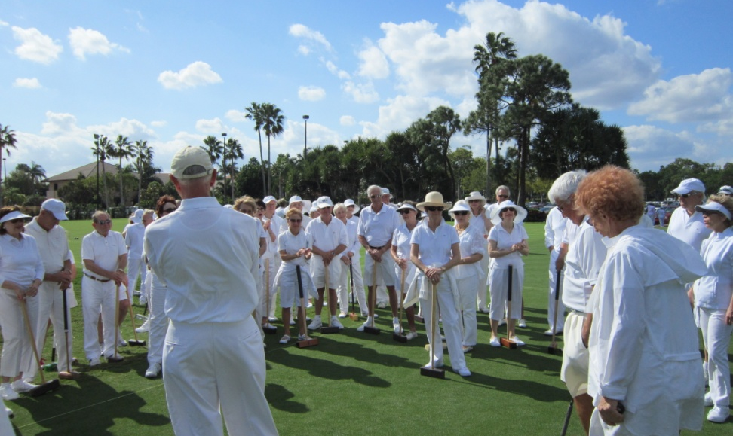
Don’t Be Left Out!
You could be losing members while you wait!

